Slide 1
Unit 7 Pattern Recognition & Artificial Neural Network in Pattern Recognition
Hour:8hrs.
Presented by
Er.Harendra Bikram Shah (Lecturer)
Department of Computer Engineering
NAST

Slide 2
OUTLINES
7.1 Image pattern and its recognition
7.2 General steps of Pattern recognition
7.3 Boundary Preprocessing, Boundary Feature Descriptors, Region Feature Descriptors
7.4 Feature extraction: PCA
7.5 Scale-Invariant Feature Transform (SIFT)
7.6 Patterns and Pattern Classes
7.7 Pattern Classification by Prototype Matching
7.8 Optimum (Bayes) Statistical Classifiers
7.9 Artificial Neural Network
7.9.1 Perceptron
7.9.2 Hopfield Network

Slide 3
Image pattern and its recognition
Image Pattern:
A set of visual features or structures within an image (e.g., shapes, textures, edges) that help in identifying or categorizing the image.
Pattern Recognition:
The process of classifying input data (patterns) into predefined categories based on either statistical or structural features.
Goals:
Identify patterns from noisy/incomplete data
Classify data using prior knowledge
Automate decision-making (e.g., face detection, medical imaging, OCR)
Features of Pattern Recognition:
recognize familiar patterns quickly and accurate
Recognize and classify unfamiliar objects
Accurately recognize shapes and objects from different angles
Identify patterns and objects even when partly hidden
Recognize patterns quickly with ease, and with automaticity.

Slide 4
Applications of Pattern Recognition
Image processing, segmentation, and analysis
Computer vision
Seismic analysis
Radar signal classification/analysis
Speech recognition
Fingerprint identification
Engineering
Astronomy
Geography

Slide 5
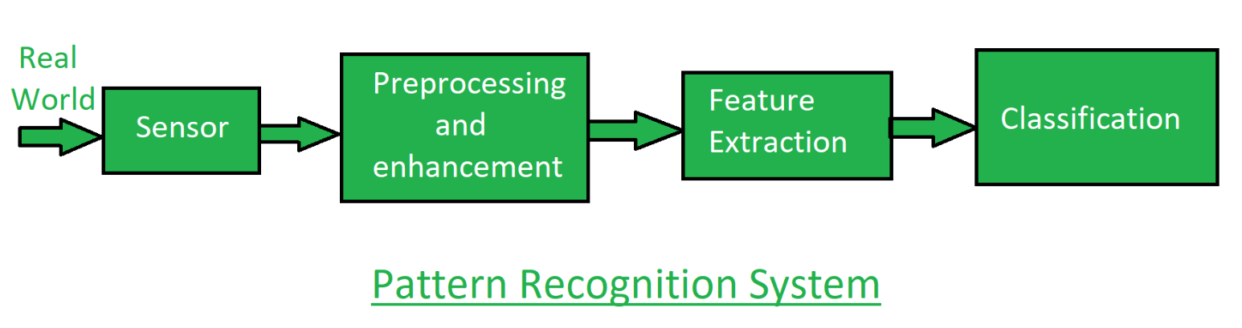
Working of Pattern Recognition

Slide 6
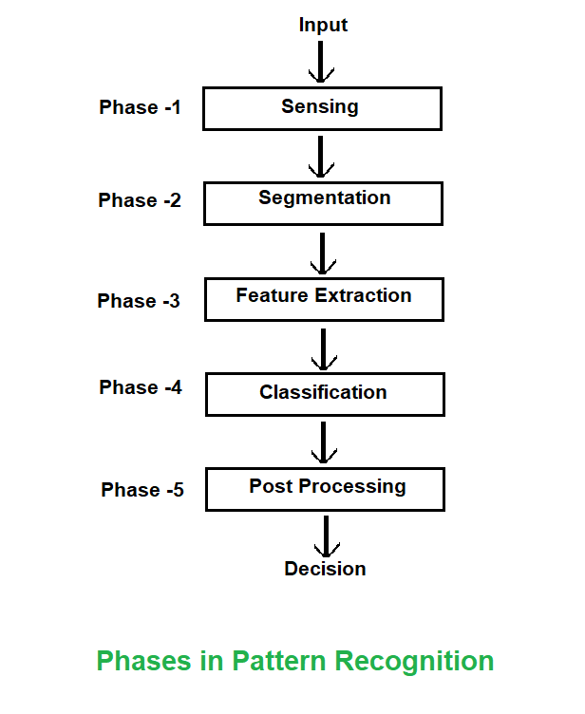
Phases/Steps in Pattern Recognition

Slide 7
Boundary Preprocessing
Boundary preprocessing involves cleaning and preparing the boundary (edge) data of objects in an image to make them suitable for further analysis, such as feature extraction or classification.
Key Techniques:
a) Smoothing:
b) Thinning :
c) Edge Linking:
d) Noise Removal:
e) Continuous Extraction:

Slide 8
Boundary Feature Descriptors
Boundary feature descriptors
It extract quantitative information from the boundary points.
These features are often translation, rotation, and scale invariant, which makes them useful for shape recognition.
Descriptor Type | Description | Key Features
Chain Code | Represents a boundary as a sequence of direction codes | Compact, easy to implement
Fourier Descriptors | Use Fourier transform to represent the boundary in frequency domain | Robust to noise, good for closed contours
Curvature Scale Space (CSS) | Describes shape based on curvature changes at multiple scales | Captures fine and coarse details
Polygonal Approximation | Approximates the boundary using straight-line segments | Reduces complexity, useful for vector representations
Shape Signatures (e.g., Centroid Distance Function) | One-dimensional representation of shape derived from boundary | Useful for comparison and matching
Invariant Moments | Statistical measures of boundary shape | Invariant to scale, rotation, translation
Applications
Object recognition
Shape classification
Medical imaging
Character recognition (OCR)
Image retrieval

Slide 9
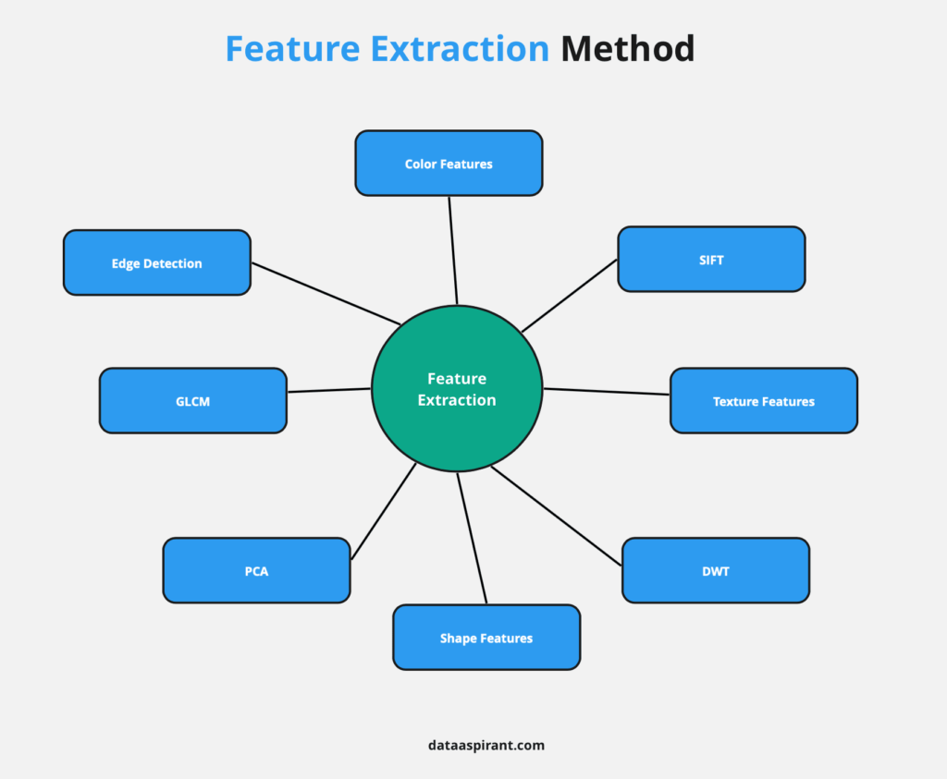
FEATURE DESCRIPTORS
Feature Descriptor in Image Processing
Feature Descriptor is basically a way of representing a part of an image that has some distinctive or interesting characteristics.
It is usually a set of numbers that describe the appearance, shape, or texture of the region around a key point.
Some applications for this would be in identifying and comparing image regions.

Slide 10
SIFT(Scale-Invariant Feature Transform)
SIFT is a robust algorithm designed to identify and describe local features in images that are invariant to scale, rotation, and partially invariant to affine transformations and illumination changes.
a computer vision algorithm to detect, describe, and match local features in images, invented by David Lowe in 1999.
Key Steps in the SIFT Algorithm
The SIFT algorithm comprises several steps, each crucial for accurately detecting and describing features. These steps are:
1.Scale-Space Extrema Detection: The first step involves identifying key points that are invariant to scale. This is achieved by constructing a scale-space representation of the image using a Gaussian function.
2. Key point Localization
Once potential key points are identified, the algorithm refines their positions to improve accuracy.
3. Orientation Assignment
Each key point is assigned one or more orientations based on the local image gradient directions. This step ensures that the key point descriptors are invariant to image rotation.
4. Key point Descriptor
The final step is to create a descriptor for each key point. This descriptor is a vector that describes the local image region around the key point

Slide 11
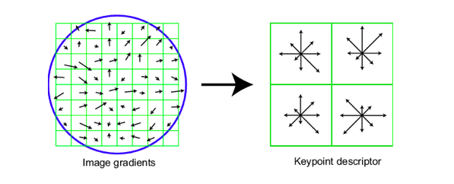
SIFT(Scale-Invariant Feature Transform)
Applications of SIFT
Object Recognition
Image Stitching
3D Reconstruction
Robot Navigation
Advantages of SIFT
Scale and Rotation Invariance:
Distinctive Descriptors:
Robustness to Noise and Illumination Changes:
Limitations of SIFT
Computational Complexity:
Patent Issues:

Slide 12
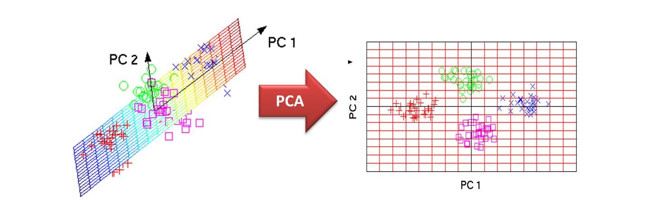
FEATURE EXTRACTION: PCA
Technique used in data analysis and machine learning.
reduce the number of features in a dataset while keeping the most important information.
It finds these by calculating eigenvectors (directions) and eigenvalues (importance) from the covariance matrix.

Slide 13
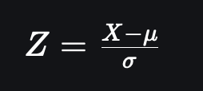
FEATURE EXTRACTION: PCA
Step 1: Standardize the Data
Different features may have different units and scales like salary vs. age.
To compare them fairly PCA first standardizes the data by making each feature have:
A mean of 0
A standard deviation of 1
where:
μ is the mean of independent features μ={μ1,μ2,⋯,μm}
σ is the standard deviation of independent features σ={σ1,σ2,⋯,σm}

Slide 14
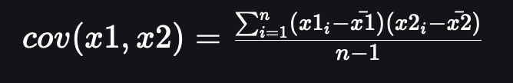
FEATURE EXTRACTION: PCA
Step 2: Calculate Covariance Matrix
Next PCA calculates the covariance matrix to see how features relate to each other whether they increase or decrease together.
The covariance between two features x1x1​ and x2x2​ is:
Where:
xˉ1andx ˉ2xˉ1​andxˉ2​​ are the mean values of features x1andx2x1​andx2​
n is the number of data points
The value of covariance can be positive, negative or zeros.

Slide 15
FEATURE EXTRACTION: PCA
Step 3: Find the Principal Components
PCA identifies new axes where the data spreads out the most:
1st Principal Component (PC1): The direction of maximum variance (most spread).
2nd Principal Component (PC2): The next best direction, perpendicular to PC1 and so on.
Step 4: Pick the Top Directions & Transform Data
After calculating the eigenvalues and eigenvectors PCA ranks them by the amount of information they capture.
We then:
Select the top k components hat capture most of the variance like 95%.
Transform the original dataset by projecting it onto these top components.

Slide 16
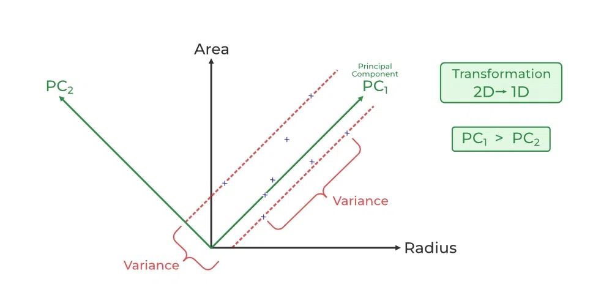
FEATURE EXTRACTION: PCA

Slide 17
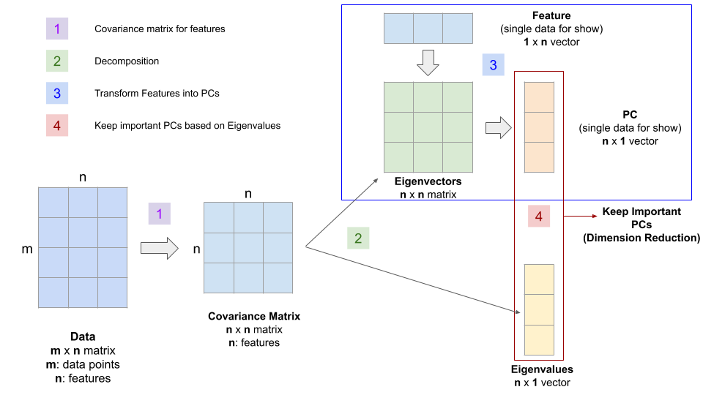
FEATURE EXTRACTION: PCA
To remember this definition, we can break it down into four steps:
We identify the relationship among features through a covariance matrix.
Through the linear transformation or eigen-decomposition of the Covariance Matrix, we get eigenvectors and eigenvalues.
Then we transform our data using Eigenvectors into principal components.
Lastly, we quantify the importance of these relationships using Eigenvalues and keep the important principal components.

Slide 18
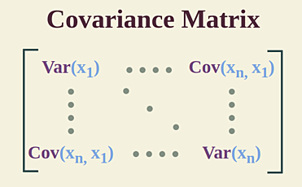
FEATURE EXTRACTION: PCA

Slide 19
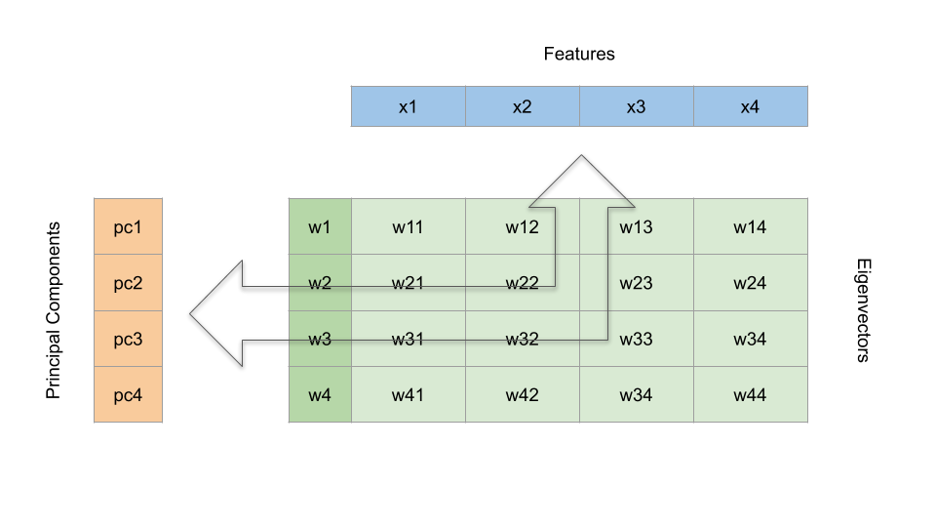
FEATURE EXTRACTION: PCA
A Simplified Visual Demo

Slide 20
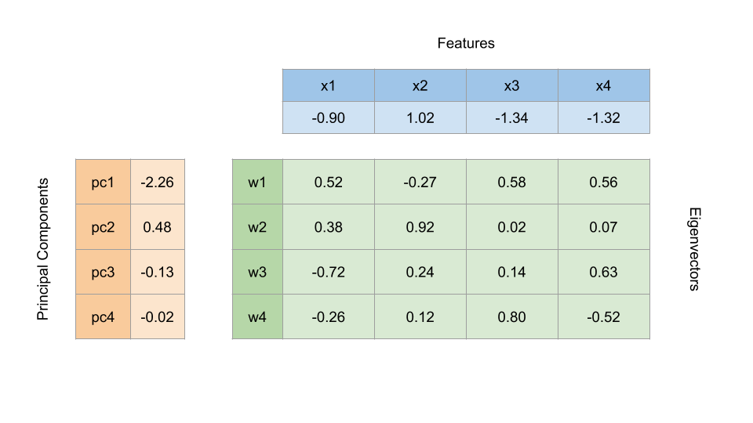
FEATURE EXTRACTION: PCA
A Simplified Visual Demo

Slide 21
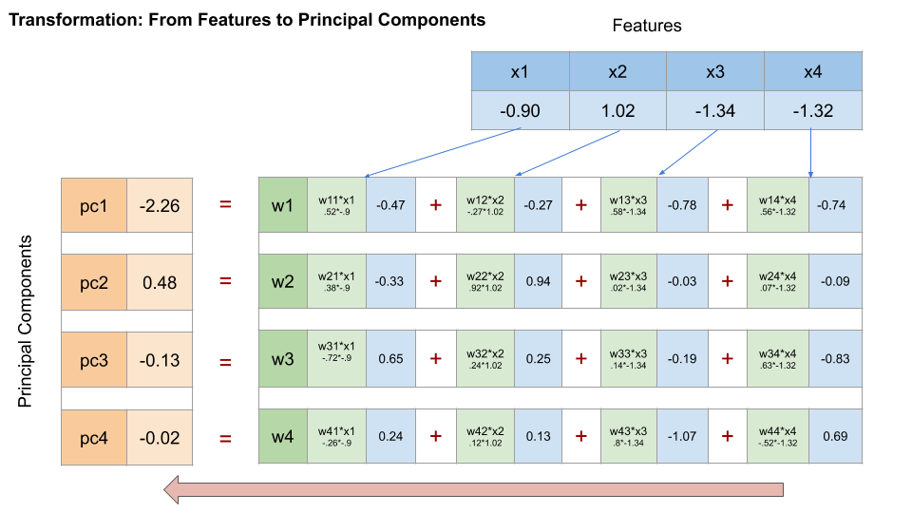
FEATURE EXTRACTION: PCA
Visual Demo for Step 3

Slide 22
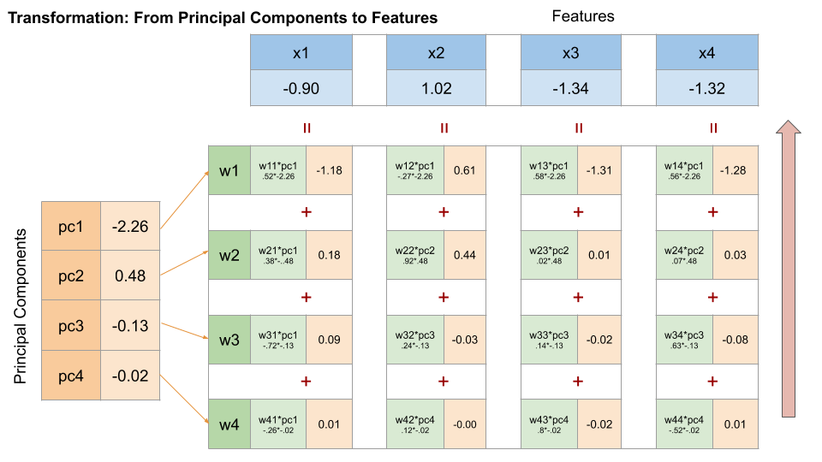
FEATURE EXTRACTION: PCA
Visual Demo for Step 3

Slide 23
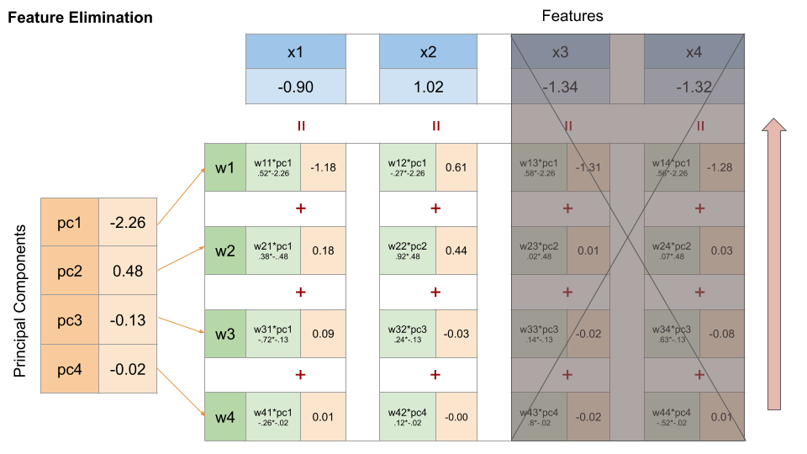
FEATURE EXTRACTION: PCA
Visual Demo for Step 4

Slide 24
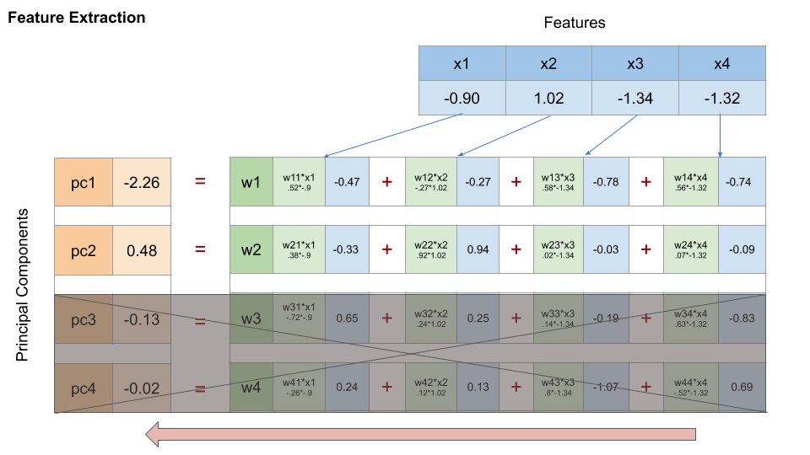
FEATURE EXTRACTION: PCA
Visual Demo for Step 4

Slide 25
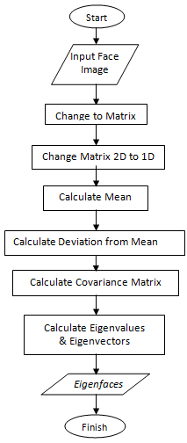
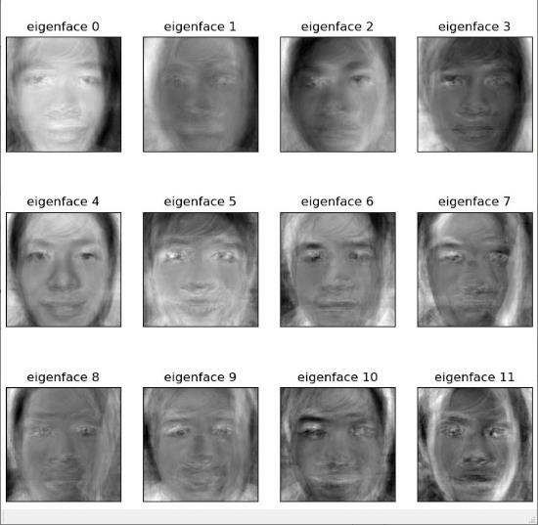
FEATURE EXTRACTION: PCA

Slide 26
FEATURE EXTRACTION: PCA
Pros of PCA
Reduces Dimensionality
Improves Model Performance
Removes Multicollinearity
Noise Reduction
Data Visualization
Cons of PCA
Loss of Interpretability
Variance-Based Only
Assumes Linearity
Sensitive to Scaling
Not Ideal for Categorical Data
Usage of PCA
Preprocessing in Machine Learning
Image Compression & Recognition
Noise Filtering
Genomics and Bioinformatics
Finance

Slide 27
PATTERNS AND PATTERN CLASSES
A pattern is a set of measurable or observable properties or features used to describe an object or event.
Example of Patterns:
A handwritten digit: described by stroke shape, size, orientation.
A fruit image: described by Color, texture, shape.
A voice sample: described by pitch, frequency, amplitude.
A pattern class is a collection of patterns that belong to the same category or label.
Examples of Pattern Classes:
All instances of the digit "5"
All red apples
All spam emails
Types of Patterns
Type | Description | Example
Statistical Patterns | Described by numerical features | Height, weight of a person
Structural Patterns | Composed of sub-patterns and relationships | Chemical molecules, language syntax
Template-based Patterns | Compared against stored templates | OCR, fingerprint matching
Neural Patterns | Patterns learned via neural networks | Images, audio, sensor data

Slide 28
PATTERN CLASSIFICATION BY PROTOTYPE MATCHING
Prototype matching is a fundamental technique in pattern classification, where an unknown pattern is compared against a set of stored prototype patterns, and is assigned to the class of the most similar prototype.
Each prototype represents a pattern class.
Similarity is measured using various distance metrics.
Steps in Prototype Matching Classification
Feature Extraction: Convert raw data into feature vectors.
Prototype Selection:
Use mean vector of each class.
Use medoid or manually selected patterns.
Distance Calculation:
Classification:

Slide 29
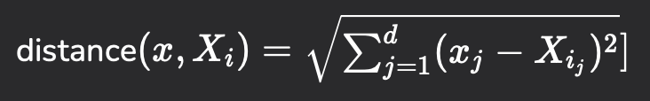
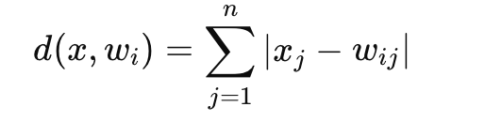
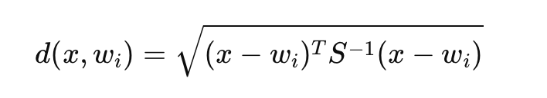
PATTERN CLASSIFICATION BY PROTOTYPE MATCHING
1. Euclidean Distance
2. Manhattan Distance:
3. Mahalanobis Distance:

Slide 30
PATTERN CLASSIFICATION BY PROTOTYPE MATCHING
Types of Prototype Matching
Nearest Prototype Classifier:
K-Nearest Neighbour Classifier:
Learning Vector Quantization (LVQ):
Advantages of Prototype Matching
Simple and easy to implement.
Works well with clearly separated classes.
Can be efficient if number of prototypes is small.
Disadvantages
Not effective with overlapping or non-linearly separable classes.
Sensitive to noise and outliers.
Requires good prototype selection for accurate results.
Applications
Handwriting and character recognition.
Biometric verification (face/fingerprint recognition).
Speech recognition.
Medical diagnosis
Remote sensing

Slide 31
K-Nearest Neighbour Algorithm
It is a supervised machine learning algorithm generally used for classification but can also be used for regression tasks.
It works by finding the "k" closest data points (neighbors) to a given input and makes a predictions based on the majority class (for classification) or the average value (for regression).
How to choose the value of k for KNN Algorithm?
The value of k in KNN decides how many neighbors the algorithm looks at when making a prediction.
Choosing the right k is important for good results.
If the data has lots of noise or outliers, using a larger k can make the predictions more stable.
But if k is too large the model may become too simple and miss important patterns and this is called underfitting.
So, k should be picked carefully based on the data.

Slide 32


K-Nearest Neighbour Algorithm
Distance Metrics Used in KNN Algorithm
1. Euclidean Distance
2. Manhattan Distance
3. Minkowski Distance

Slide 33
Working of K-Nearest Neighbour Algorithm
Step 1: Selecting the optimal value of K
K represents the number of nearest neighbors that needs to be considered while making prediction.
Step 2: Calculating distance
To measure the similarity between target and training data points Euclidean distance is used. Distance is calculated between data points in the dataset and target point.
Step 3: Finding Nearest Neighbors
The k data points with the smallest distances to the target point are nearest neighbors.
Step 4: Voting for Classification or Taking Average for Regression
When you want to classify a data point into a category like spam or not spam, the KNN algorithm looks at the K closest points in the dataset. These closest points are called neighbors.

Slide 34
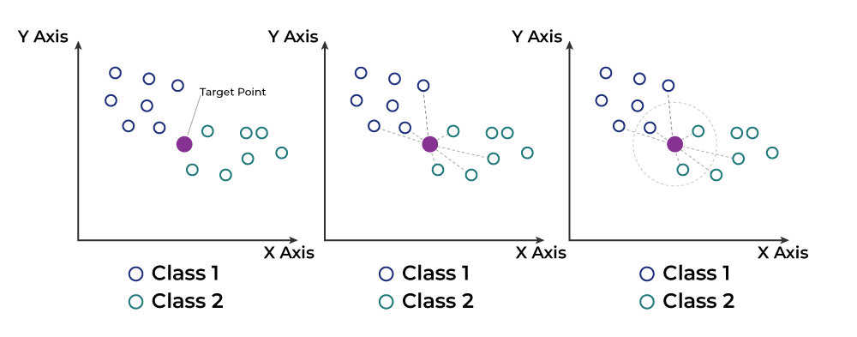
Working of K-Nearest Neighbour Algorithm

Slide 35
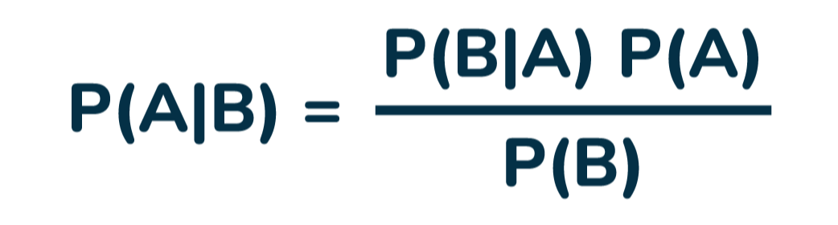
OPTIMUM (BAYES) STATISTICAL CLASSIFIERS
Bayes' Theorem is a mathematical formula used to determine the conditional probability of an event based on prior knowledge and new evidence.
It adjusts probabilities when new information comes in and helps make better decisions in uncertain situations.
Where,
P(A) and P(B) are the probabilities of events A and B; also, P(B) is never equal to zero.
P(A|B) is the probability of event A when event B happens,
P(B|A) is the probability of event B when A happens.

Slide 36
OPTIMUM (BAYES) STATISTICAL CLASSIFIERS
Bayes Theorem Applications
Medical Testing → Finding the real probability of having a disease after a positive test.
Spam Filters → Checking if an email is spam based on keywords.
Weather Prediction → Updating the chance of rain based on new data.
AI & Machine Learning

Slide 37
OPTIMUM (BAYES) STATISTICAL CLASSIFIERS
Bayes Classification is a Supervised machine learning approach for classification.
It works on a probabilistic method which uses Bayes Theorem
It's based on Bayes’ Theorem, named after Thomas Bayes, an 18th-century statistician.
The theorem helps update beliefs based on evidence, which is the core idea of classification here: updating class probability based on observed data.
Key Features of Bayes Classifier
Probabilistic Model:
Supervised Learning Approach:
Classifies Using Prior and Likelihood:
Model Interpretability:
Scalability:
Handles Continuous/Discrete Features:

Slide 38
Assumptions in Bayes Classification
Well-defined prior probabilities.
Correct conditional probability distributions.
Independence of training and test samples.
Stationarity of features over time.
Classes are mutually exclusive and exhaustive.

Slide 39
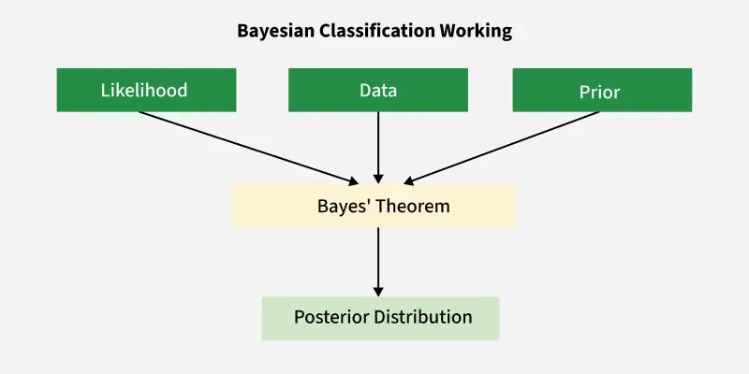

Slide 40
Steps Involved in Classification
Collect Data: From training set, extract features X and target C.
Estimate Priors: Calculate P(C) for each class.
Estimate Likelihoods: For every feature X, compute P(X∣C).
Calculate Posterior: Use Bayes’ Theorem to get P(C∣X).
Predict Class:

Slide 41
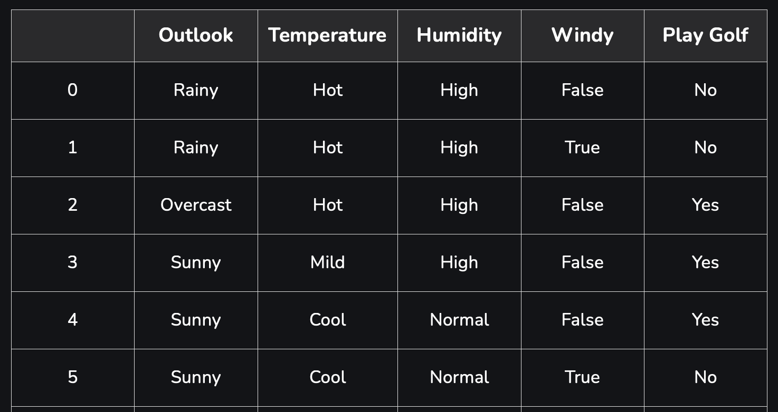
Naive Bayes Classifier
It is a classification algorithm that uses probability to predict which category a data point belongs to, assuming that all features are unrelated.
The main idea behind the Naive Bayes classifier is to use Bayes Theorem to classify data based on the probabilities of different classes given the features of the data.
It is named as "Naive" because it assumes the presence of one feature does not affect other features.
The "Bayes" part of the name refers to its basis in Bayes’ Theorem.
Consider a fictional dataset that describes the weather conditions for playing a game of golf. Given the weather conditions, each tuple classifies the conditions as fit(“Yes”) or unfit(“No”) for playing golf. Here is a tabular representation of our dataset.

Slide 42
Assumption of Naive Bayes
Feature independence:
Continuous features are normally distributed:
Discrete features have multinomial distributions:
Features are equally important:
No missing data:

Slide 43

Naive Bayes Working
1. Terminology
Consider a classification problem (like predicting if someone plays golf based on weather). Then:
y is the class label (e.g. "Yes" or "No" for playing golf)
X=(x1,x2,...,xn) is the feature vector (e.g. Outlook, Temperature, Humidity, Wind)
A sample row from the dataset:
X=(Rainy, Hot, High, False), y=No
2. The Naive Assumption
The "naive" in Naive Bayes comes from the assumption that all features are independent given the class. That is:
P(x1,x2,...,xn∣y) = P(x1∣y)⋅P(x2∣y)⋯P(xn∣y)
Thus, Bayes' theorem becomes:

Slide 44
3. Constructing the Naive Bayes Classifier
We compute the posterior for each class y and choose the class with the highest probability:
4. Example: Weather Dataset
Let’s take a dataset used for predicting if golf is played based on:
Outlook: Sunny, Rainy, Overcast
Temperature: Hot, Mild, Cool
Humidity: High, Normal
Wind: True, False

Slide 45
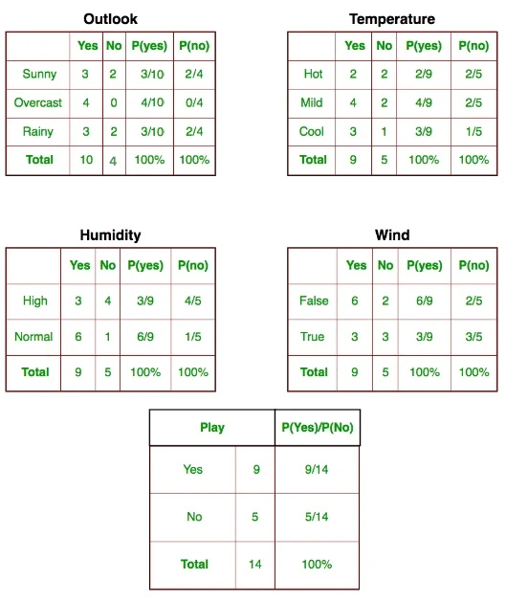

Slide 46
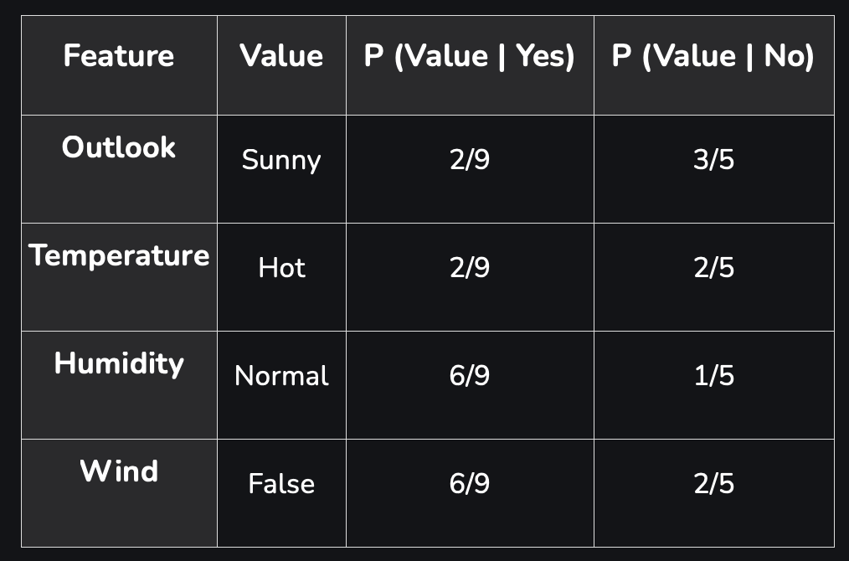
5. Pre-computation from Dataset

Slide 47
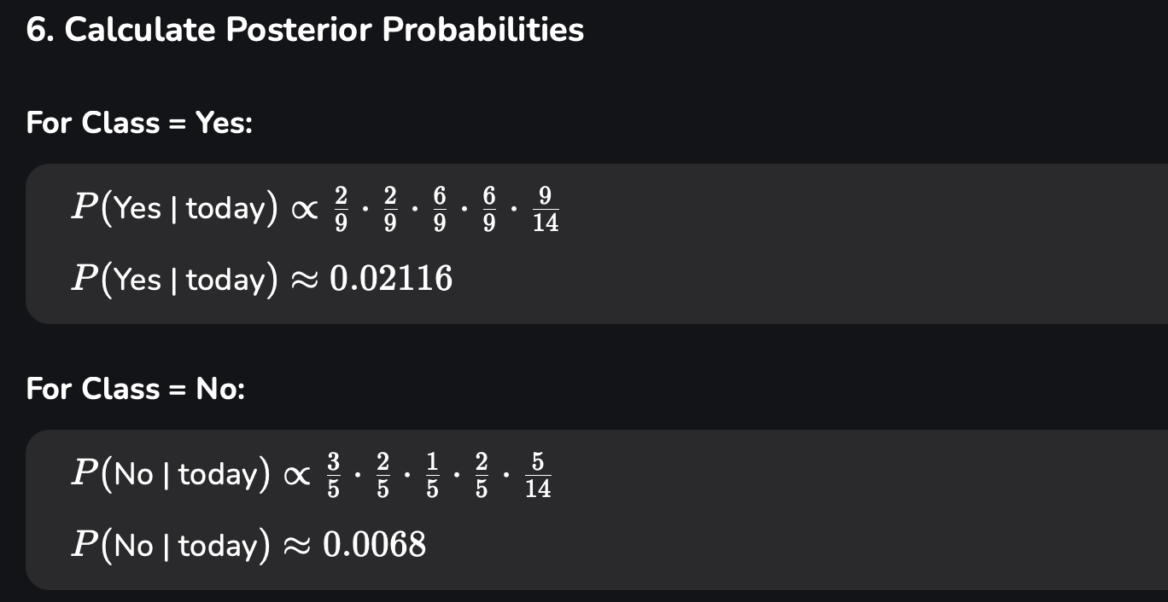

Slide 48
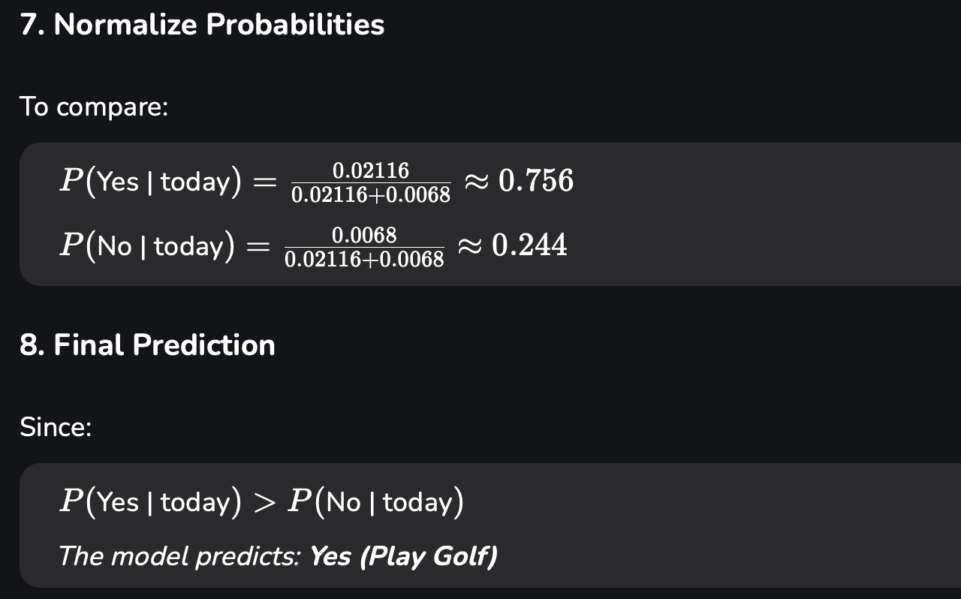

Slide 49
Advantages of Naive Bayes Classifier
Easy to implement and computationally efficient.
Effective in cases with a large number of features.
Performs well even with limited training data.
It performs well in the presence of categorical features.
For numerical features data is assumed to come from normal distributions
Disadvantages of Naive Bayes Classifier
Assumes that features are independent, which may not always hold in real-world data.
Can be influenced by irrelevant attributes.
May assign zero probability to unseen events, leading to poor generalization.

Slide 50
Applications of Naive Bayes Classifier
Spam Email Filtering:
Text Classification:
Medical Diagnosis:
Credit Scoring:
Weather Prediction:

Slide 51
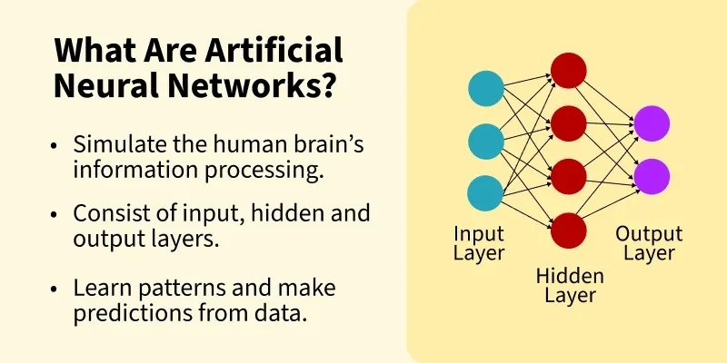
Artificial Neural Network

Slide 52
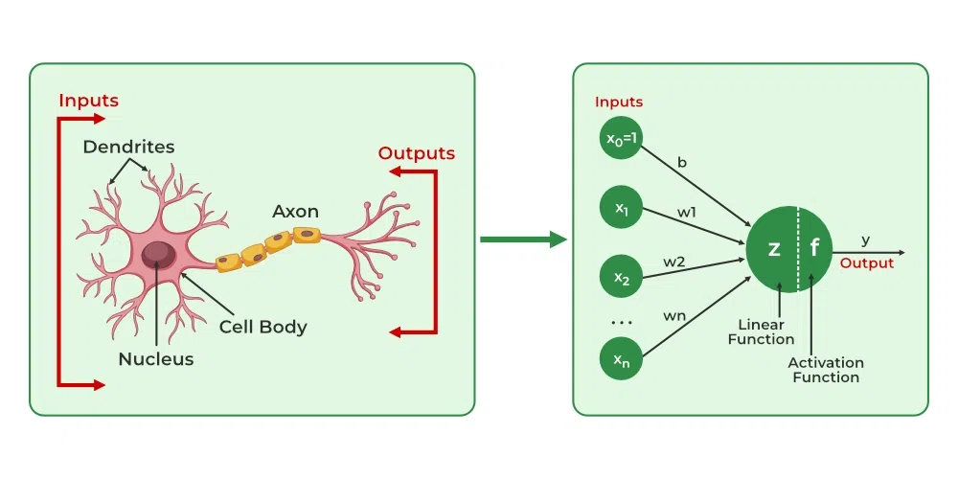
Artificial Neural Network

Slide 53
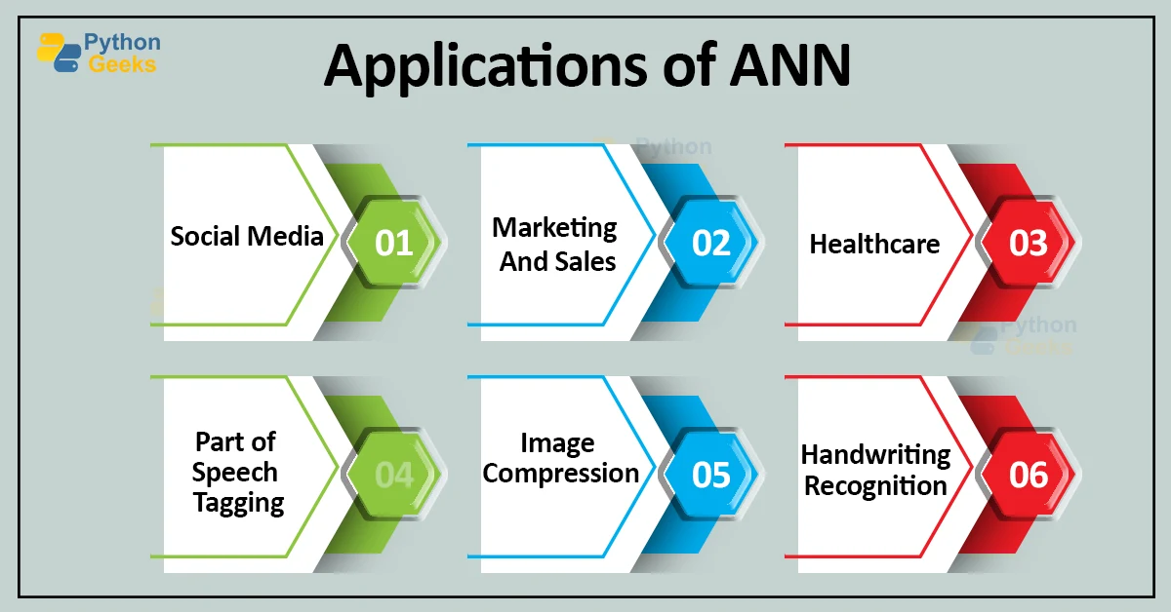
Artificial Neural Network
Applications of ANN in Image Processing
A. Image Classification
B. Image Segmentation
C. Image Enhancement
D. Object Detection
E. Pattern Recognition

Slide 54
Artificial Neural Network
Advantages of ANN in Image Processing
Learns features automatically
Capable of handling large image datasets.
Tolerant to distortions and partial occlusions.
Generalizes well for similar image types.
Limitations of ANN
Requires large datasets for training.
High computational power and memory.
May suffer from overfitting without regularization.
Less effective for spatial pattern recognition.
Tools and Libraries
TensorFlow / Keras
PyTorch
MATLAB
OpenCV (with ML integration)

Slide 55
Perceptron
The Perceptron is one of the simplest artificial neural network architectures, introduced by Frank Rosenblatt in 1957. It is primarily used for binary classification.
Types of Perceptron
Single Layer Perceptron: It is a type of perceptron is limited to learning linearly separable patterns.
Multi-Layer Perceptron : possess enhanced processing capabilities as they consist of two or more layers, adept at handling more complex patterns and relationships within the data.
Basic Components of Perceptron
Input Features: The perceptron takes multiple input features, each representing a characteristic of the input data.
Weights: Each input feature is assigned a weight that determines its influence on the output.
Summation Function: The perceptron calculates the weighted sum of its inputs, combining them with their respective weights.
Activation Function :the Heaviside step function, comparing it to a threshold to produce a binary output (0 or 1).
Output: The final output is determined by the activation function, often used for binary classification tasks.
Bias: The bias term helps the perceptron make adjustments independent of the input, improving its flexibility in learning.
Learning Algorithm:

Slide 56
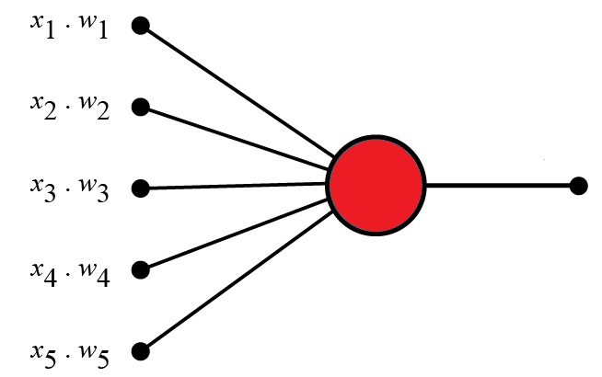
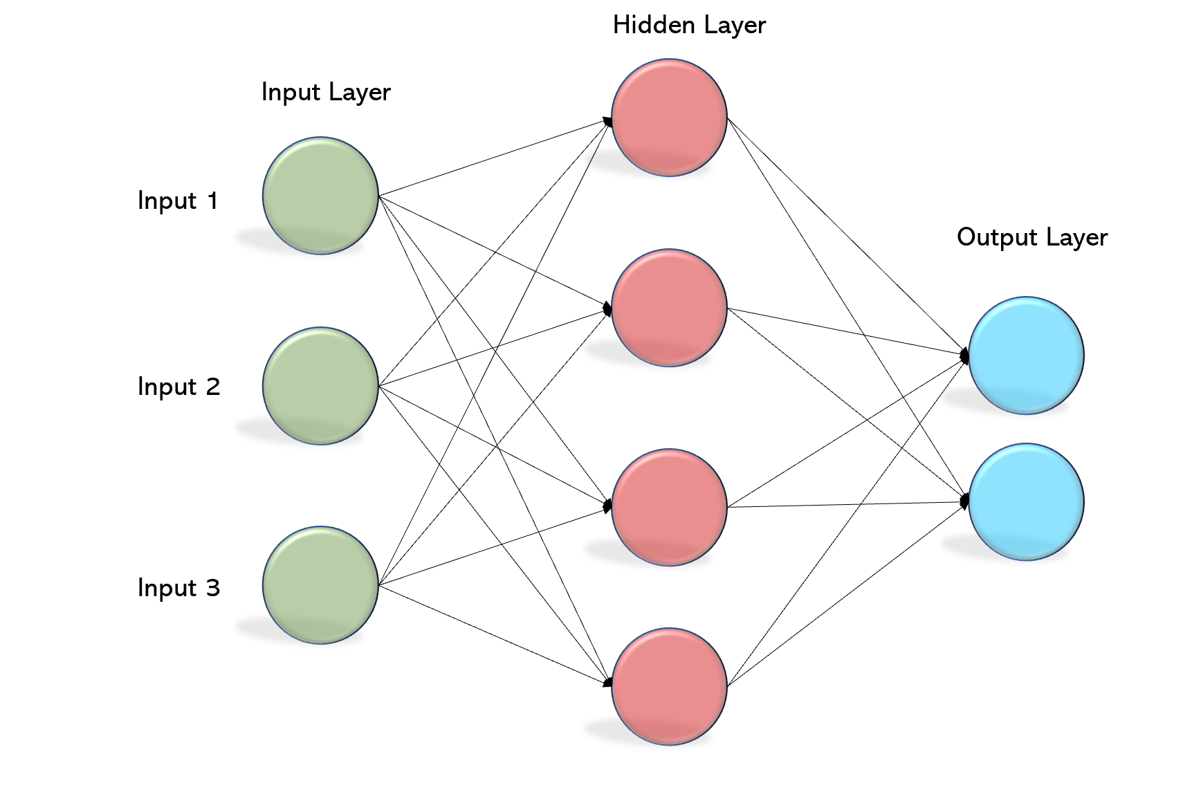
Perceptron
The Perceptron Algorithm
Frank Rosenblatt suggested this algorithm:
Set a threshold value
Multiply all inputs with its weights
Sum all the results
Activate the output

Slide 57
Perceptron
Perceptron Example
Imagine a perceptron (in your brain).
The perceptron tries to decide if you should go to a concert.
Is the artist good? Is the weather good?
What weights should these facts have?
Criteria | Input | Weight
Artists is Good | x1 = 0 or 1 | w1 = 0.7
Weather is Good | x2 = 0 or 1 | w2 = 0.6
Friend will Come | x3 = 0 or 1 | w3 = 0.5
Food is Served | x4 = 0 or 1 | w4 = 0.3
Alcohol is Served | x5 = 0 or 1 | w5 = 0.4

Slide 58
Perceptron
1. Set a threshold value:
Threshold = 1.5
2. Multiply all inputs with its weights:
x1 * w1 = 1 * 0.7 = 0.7
x2 * w2 = 0 * 0.6 = 0
x3 * w3 = 1 * 0.5 = 0.5
x4 * w4 = 0 * 0.3 = 0
x5 * w5 = 1 * 0.4 = 0.4
3. Sum all the results:
0.7 + 0 + 0.5 + 0 + 0.4 = 1.6 (The Weighted Sum)
4. Activate the Output:
Return true if the sum > 1.5 ("Yes I will go to the Concert")

Slide 59
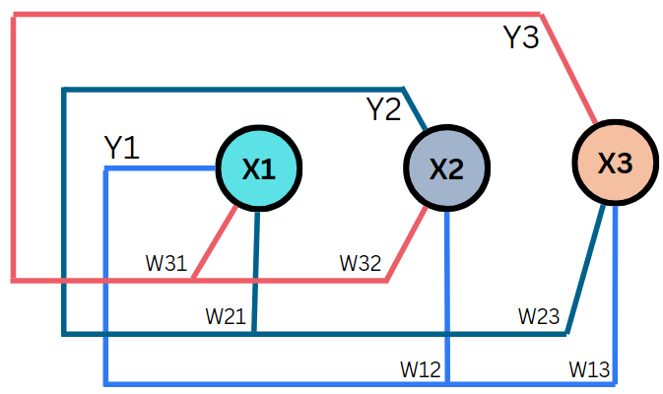
HOPFIELD NETWORK
It is a fully connected neural network where each neuron is connected to every other neuron (excluding self-connections).
Created By John Hopfield in 1982.

Slide 60
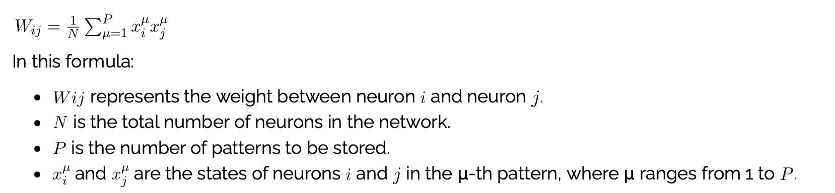
TRAINING A HOPFIELD NETWORK
Fully connected: Each neuron is connected to every other neuron (except itself).
Symmetric weights: wij=wji
Binary or bipolar states: Neurons typically take values of 0/1 (binary) or −1/+1 (bipolar).
Energy-based model: The network updates to reduce its energy and eventually converges to a stable state (local minimum).

Slide 61
TRAINING A HOPFIELD NETWORK
Applications in Image Processing
Image Restoration:
Pattern Recognition:
Image Segmentation:
Edge Detection:
Optimization for Image Compression:

Slide 62
End of Unit

Slide 63
THANK YOU

